Slide 1
DATA SCIENCE
11 WEEK PART TIME COURSE
Week 10 - Less Technical Skills
(but still really important)
Wednesday 18th May 2016

Slide 2
AGENDA
Non technical skills
Communication
Presentation
Networking
Résumé
Interviews
Lab
Discussion

Slide 3





EMAIL ONE OF THE GUEST PRESENTERS OF THIS CLASS
DATA SCIENCE - Week 9

Slide 4
COMMUNICATION
DATA SCIENCE PART TIME COURSE

Slide 5

COMMUNICATION
Who’s the audience?
Clear and concise
Know the business
Always ask why
What’s the lever?
Over-Communication is better than under-communication
Listen hard
Break bread

Slide 6
COMMUNICATION
Does it reveal something that couldn’t be done in Excel?
No speling errors!
What would happen if your document was forwarded to other people in the organisation?
Are you communicating in the same language?

Slide 7
PRESENTATION
DATA SCIENCE PART TIME COURSE

Slide 8

PRESENTATION
How you present your work will determine if it gets implemented.
If your work isn’t implemented then it’s worthless
Start with the results and action then dive into how you got there.
Can your audience understand what’s in front of them?
What questions do you think your audience will have?
Peer Review

Slide 9
PRESENTATION
Explain complex concepts in three stages if you have a mixed audience
Very general level - something your Mum would understand
Slightly technical - something an analyst would understand
More technical - something a peer would understand that communicates the key points

Slide 10
NETWORKING
DATA SCIENCE PART TIME COURSE

Slide 11


NETWORKING
Sydney is an incredibly connected place for Data Science
Meetups are a great way to socialise and find people with common interests.
Conferences are great too (but harder to make lasting connections)
Your workplace may have some great people you may not have realised - talk to people!

Slide 12
RÉSUMÉ
DATA SCIENCE PART TIME COURSE

Slide 13
RÉSUMÉ - from datascienceresume.com
Tailor it to the position you are applying for
Relevant experience
Format
Keep it to one page
Use past tense
Keep any descriptions succinct
Avoid colour coding
Send it as a pdf (the best way to ensure there are no scaling issues)

Slide 14
RÉSUMÉ - from datascienceresume.com
Only include a "Interests/Hobbies" section if
(a) you make it specific such that it conveys something about yourself
(b) you have the sense from networking / interactions with the company you're applying to, that they value some of the softer skills.

Slide 15
RÉSUMÉ - from datascienceresume.com
Proof Points
Relevant thesis
Relevant course(s) taken - and grades if available
Independent projects completed (e.g., Kaggle, self-driven work)
Github profile - especially with the code from the independent projects
Technical blog

Slide 16
RÉSUMÉ
Don’t lie
Brush up on technology you use before an interview
Highlight the benefits of your analysis (e.g. x% reduction in customer churn which increased revenue by $y)
What were some of the major projects you worked on?
What was the purpose of them?
What did you contribute?
What technologies did you use to complete the project?

Slide 17
INTERVIEWS
DATA SCIENCE PART TIME COURSE

Slide 18
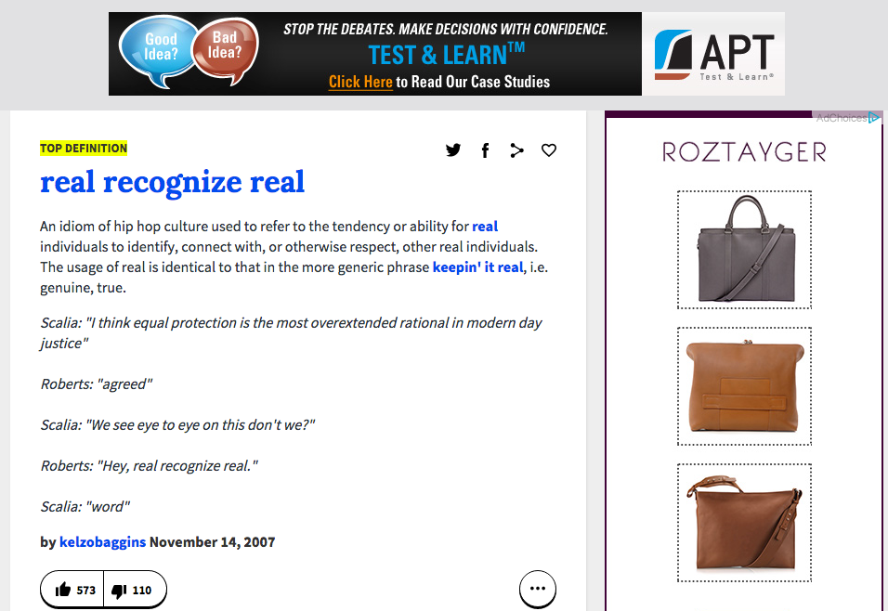
INTERVIEWS

Slide 19
INTERVIEWS - TYPICAL TECHNICAL QUESTIONS
What is R² (for linear regression)
How do you assess whether to include a variable in a linear regression model?
How would you assess model accuracy?
Explain what regularization is and why it is useful.
Explain what resampling methods are and why they are useful. Also explain their limitations.
Give an example of how you would use experimental design to answer a question about user behaviour.

Slide 20
INTERVIEWS - TYPICAL TECHNICAL QUESTIONS
What is a recommendation engine? How does it work?
Which tools do you use for visualization? What do you think of Tableau? R? SAS? (for graphs). How to efficiently represent 5 dimension in a chart?
Are you familiar with pricing optimization, price elasticity, inventory management, competitive intelligence? Give examples.
How can you prove that one improvement you've brought to an algorithm is really an improvement over not doing anything?

Slide 21
INTERVIEWS - HILARY MASON’S QUESTIONS
1. What was the last thing that you made for fun?
2. What's your favourite algorithm? Can you explain it to me?
3. Tell me about a data project you've done that was successful. How did you add unique value?
4. Tell me about something that failed. What would you change if you had to do it over again? ...
5. You clearly know a bit about our data and our work. When you look around, what's the first thing that comes to mind as "why haven't you done X"?! ...

Slide 22
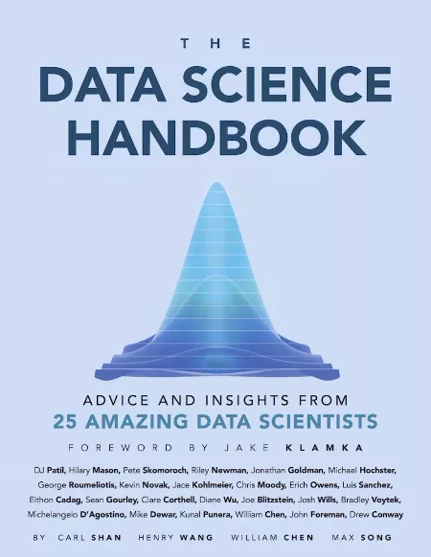
INTERVIEWS

Slide 23

LAB
DATA SCIENCE PART TIME COURSE

Slide 24
DISCUSSION
Presentations
Tasks
DATA SCIENCE - Week 10 Day 2

Slide 25
PRESENTATIONS
10 mins presentation with 5 mins for questions
What did you do?
What were the results?
What did you achieve?
What did you learn?
What else will you try in the future?
Appendix with any interesting findings
DATA SCIENCE - Week 10 Day 2

Slide 26
Task List
Let me know if you’d like to present on Monday 30th May or Wednesday 1st June
Do a draft outline of the talk and put it in
Do more modelling :)
Read about network analysis here, http://www.cs.cornell.edu/home/kleinber/networks-book/ Chapters 1 and 2
DATA SCIENCE - Week 10 Day 2

